Slide 1

Financial Chatbot:
AI Intelligent Agent
Developer : Pratik Rathod
Date : 13-04-2025

Slide 2
Financial Chatbot
The AI-based Financial Chatbot is an intelligent system designed to extract, store, and analyze financial data from multiple sources such as PDFs, CSVs, Excels, text files, and URLs. It allows users to interact with their financial data using natural language queries, delivering accurate and context-aware responses.

Slide 3
Key Functionalities
Data Ingestion(PDF, Excel, CSV, TXT, URL)
Smart Storage(PostgreSQL / MySQL/Faiss Vector Database)
AI-Powered Agent System (LangChain agents )
Natural Language Interaction
Frontend Interface
Traceability and Debugging

Slide 4
What is Agents?
An Agent is an intelligent decision-maker that understands the user's question and decides how to find the best answer—whether by querying SQL data or using document search with vector similarity.

Slide 5
How the Agent Works:
Understands User Query
Parses the natural language question to understand the intent.
Tool Selection
Automatically decides: Use SQL Tool for structured data queries Use Vector DB Tool for document-based questions
3. Executes & Responds
Runs the selected tool, retrieves the answer, and responds conversationally.

Slide 6
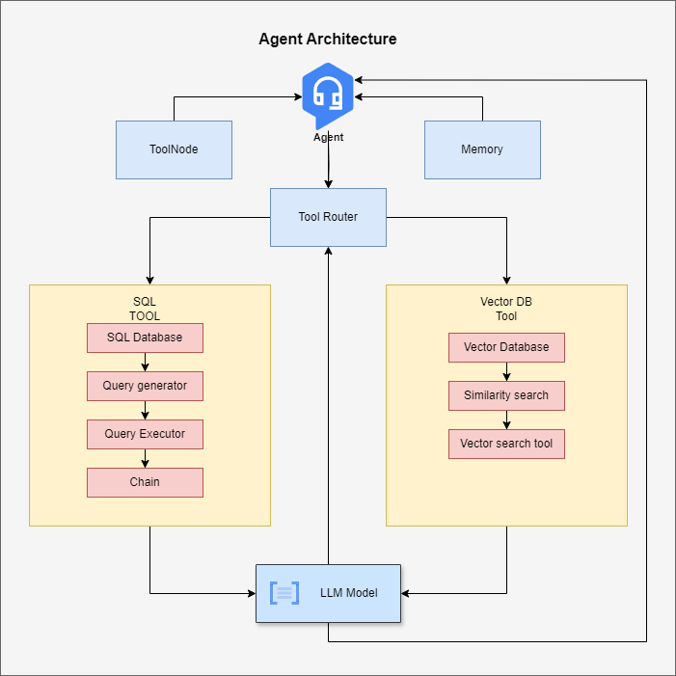
Architecture of Agent

Slide 7

Rationale
Why Agentic Chatbot?
Saves time on manual data analysis
Reduces dependency on SQL experts
Makes financial data analysis accessible to non-technical users
Scalable for enterprise-level document intelligence

Slide 8
Technical Details
Integrations with Financial Chatbot
Python (Programming Language)
Faiss (VectorDB)
OpenAI Model (GPT-3.5-turbo | Gpt-4o-mini)
HuggingFace Embedding
Langchain DocumentLoader(PDF Loader)
Langgraph ( Agent graph builder)
Mysql
Fastapi
UI(Streamlit)

Slide 9
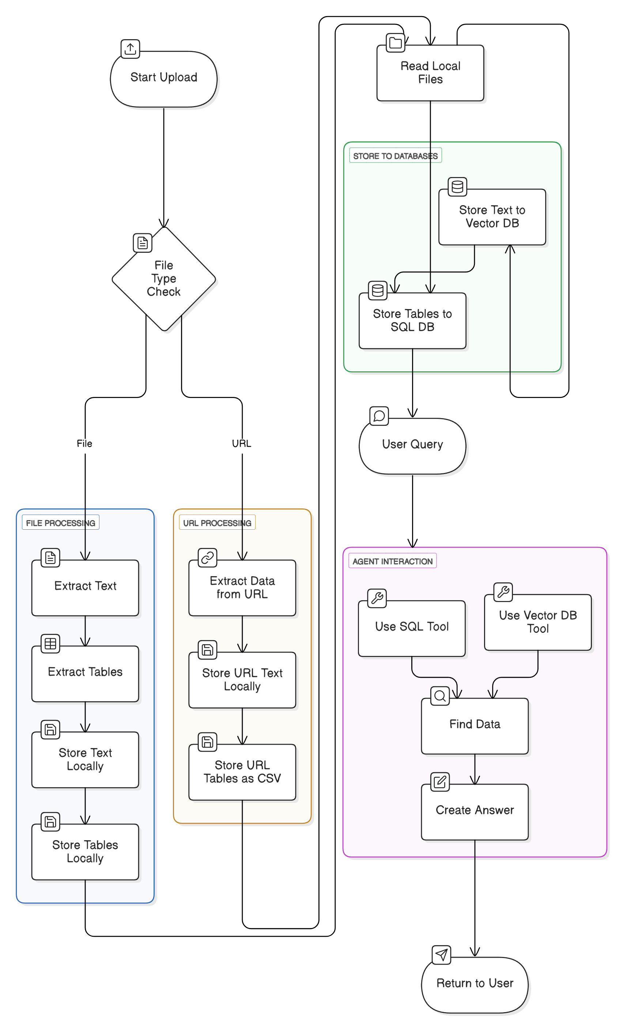
Application Diagram

Slide 10

Use Cases
Finance Teams can upload reports and analyze key metrics instantly.
Analysts can run quick queries over massive documents without manual filtering.
Auditors & Consultants can verify data and generate insights from contracts or financial sheets.

Slide 11
Thank you for your time and attention 🙂

